Slide 1
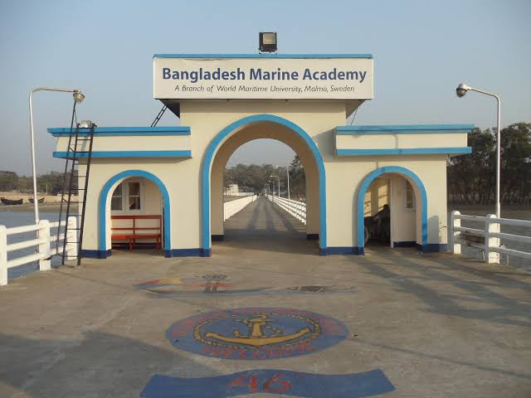
Introduction to Marine VHF Radio
Essential Communication for Safe Marine Navigation
Presented by
LC Antor
SC Mohaiminul
SC Tawhid
SC Hady

Slide 2
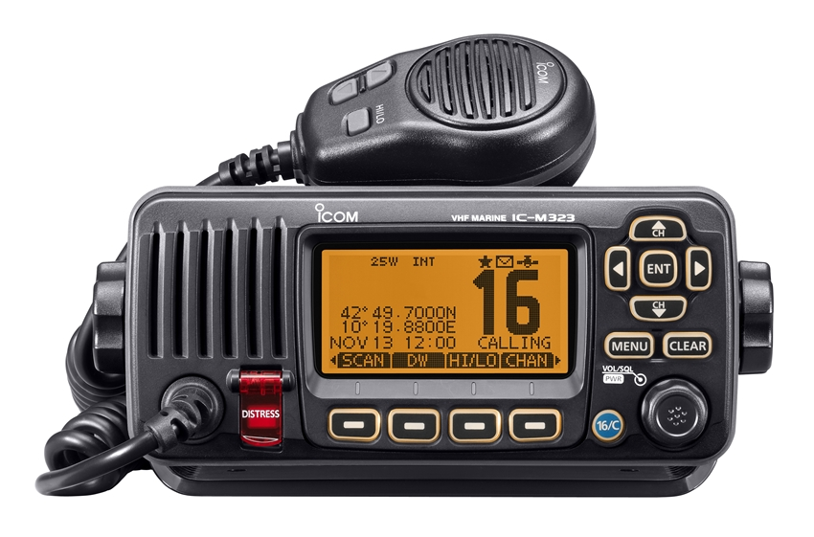
What is Marine VHF Radio?
Marine VHF stands for Very High Frequency radio used in marine communication. It operates between 156 to 174 MHz, offering line-of-sight range communication over water. Designed for short-distance, reliable, and quick voice communication. Used for: Routine communication between ships and coastal stations Emergency transmissions Navigation assistance and port coordination It’s regulated internationally by organizations like IMO and ITU to ensure uniformity.

Slide 3
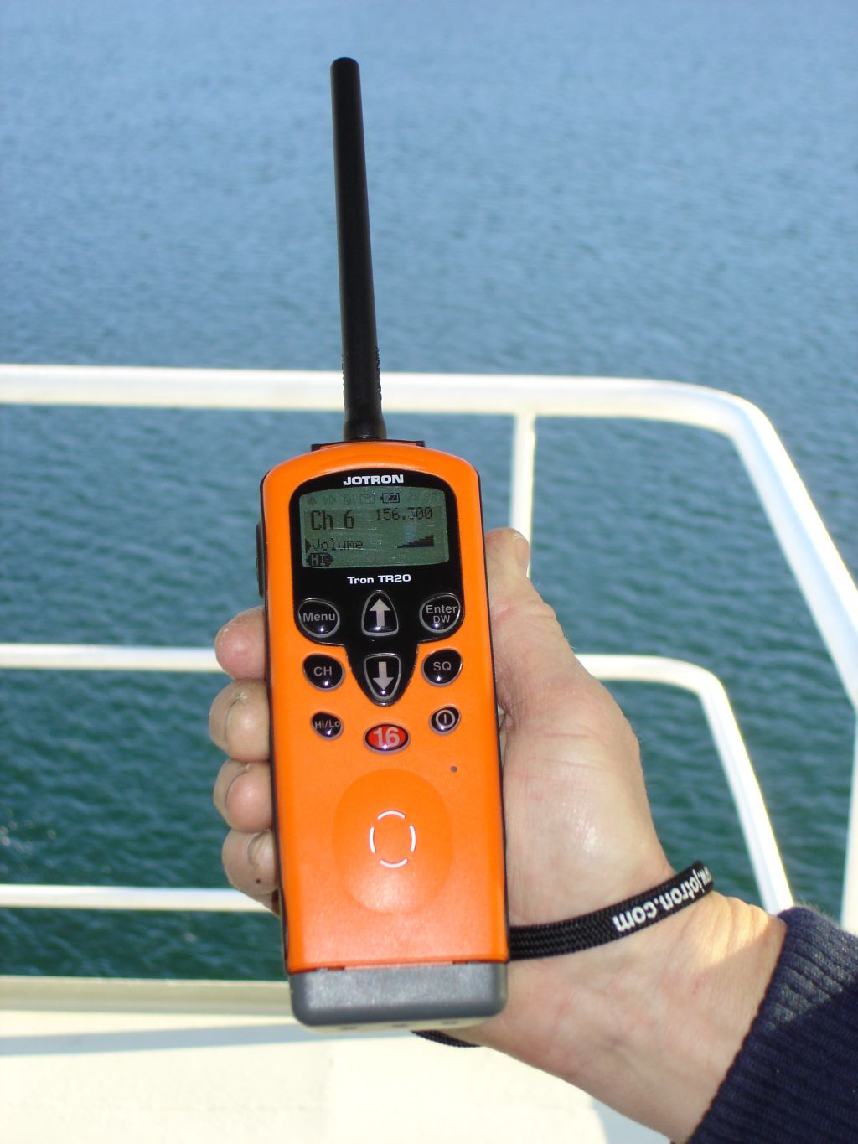
Why Marine VHF is Essential
Safety First: It is the primary method for sending distress signals and requesting immediate help. Universal on Water: All vessels, big or small, are expected to use it for coordination. Real-time Communication: Faster than satellite or mobile communication. Situational Awareness: Helps maintain awareness about other vessels in the vicinity.
Compliance: It is a legal requirement for many commercial and pleasure vessels.
Example Use Case: A fishing vessel using VHF to avoid collision with a cargo ship in foggy weather.

Slide 4
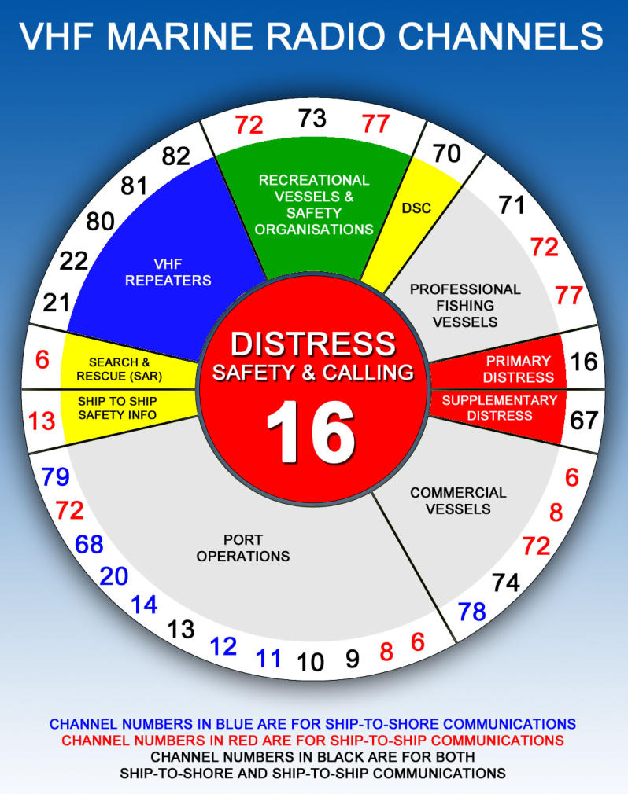
Understanding VHF Channels
Marine VHF channels are divided by purpose:
Ch. 16 (156.8 MHz): Distress, safety, and calling channel. All vessels must monitor it. Ch. 70: Used for DSC (Digital Selective Calling) only. No voice transmission. Ch. 13: Used for bridge-to-bridge communication (maneuvering). Ch. 6, 9, 72, 77: General ship-to-ship or ship-to-shore operations.
Channels are duplex or simplex, meaning either both ends can talk simultaneously or one at a time.

Slide 5
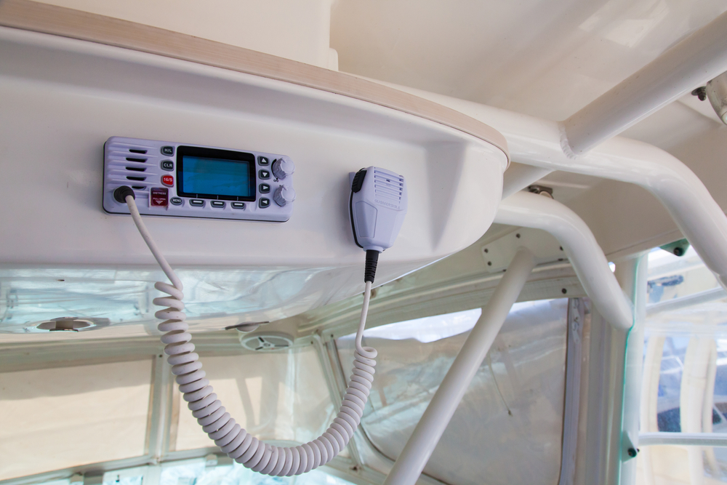
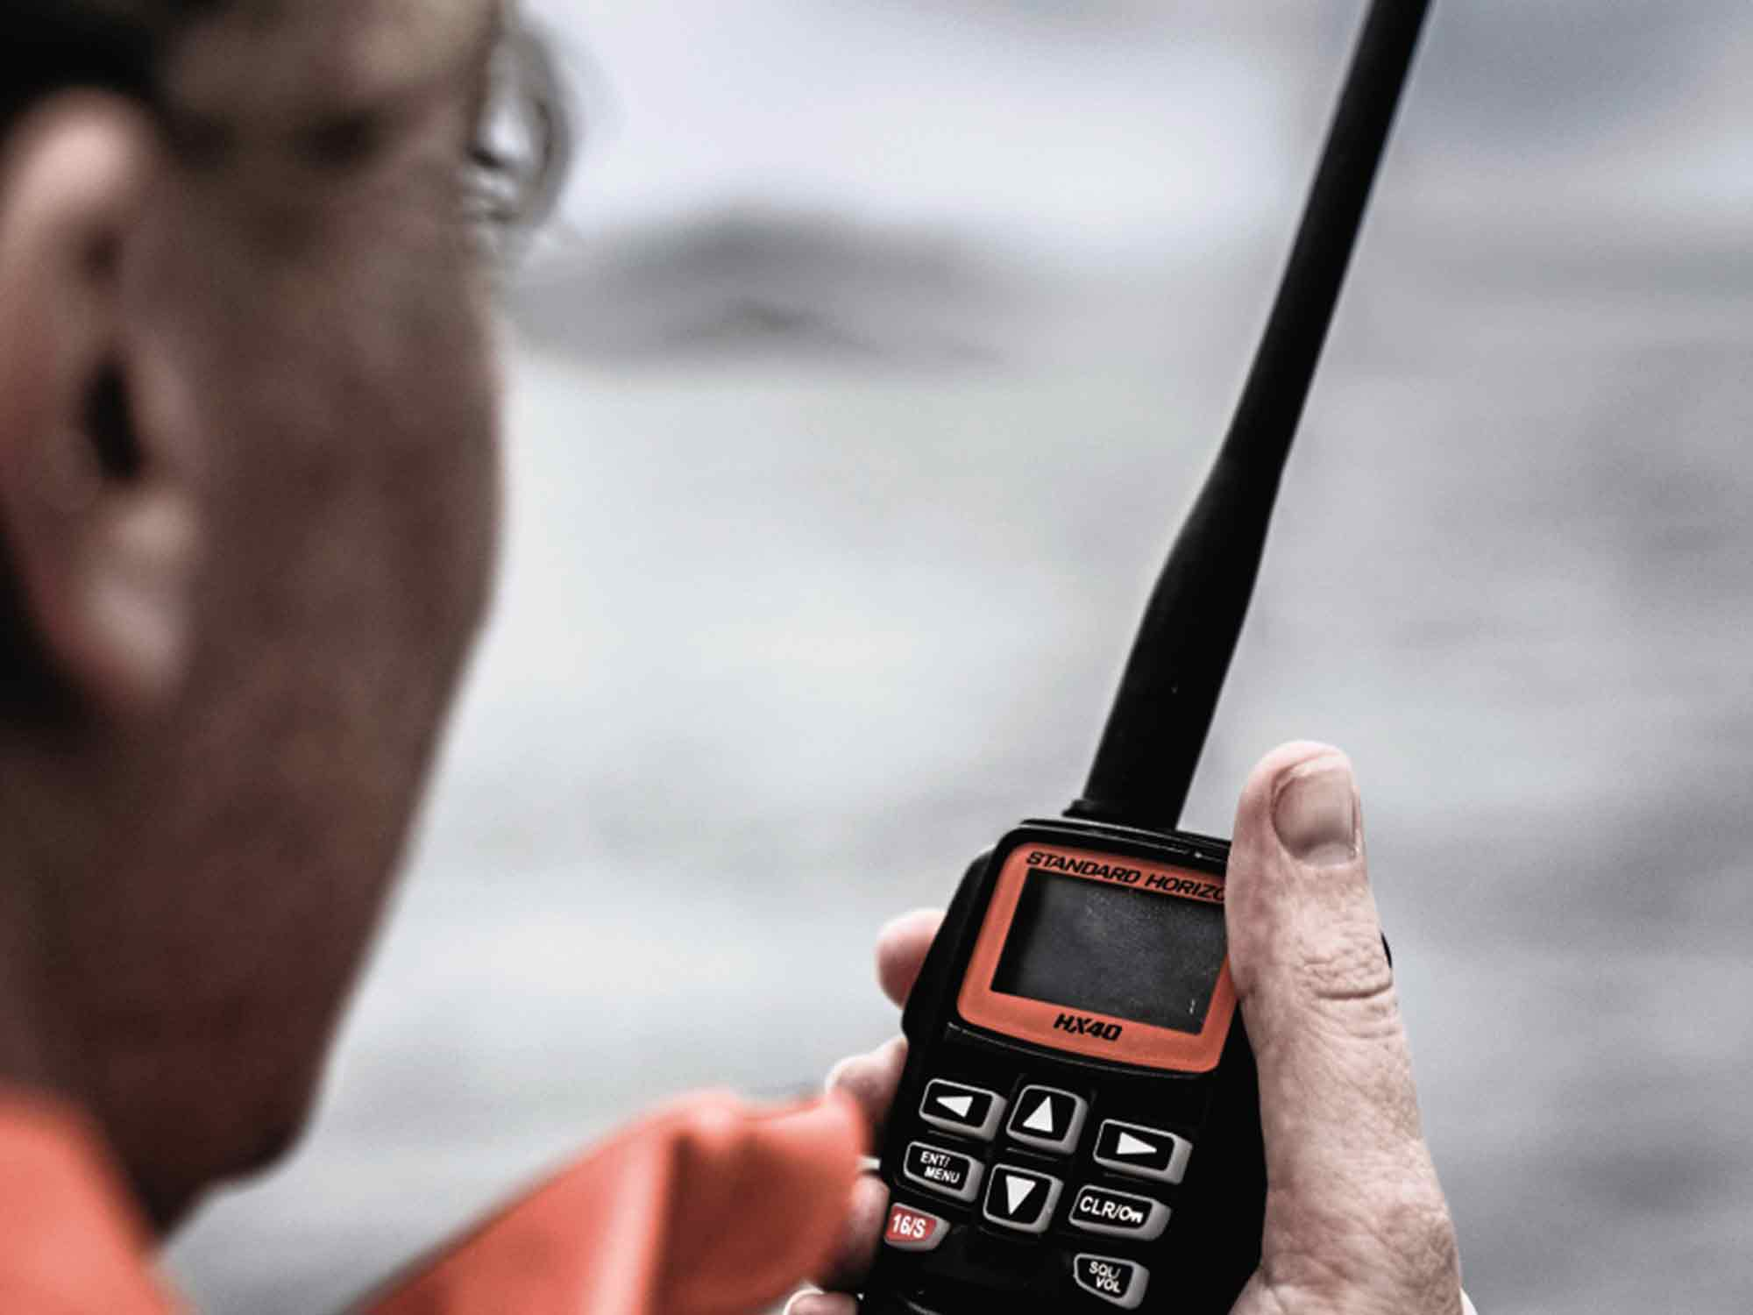
Types of Marine VHF Radios
1. Fixed-Mount VHF Radios: Installed on the vessel’s bridge Higher transmitting power (25 watts) External antenna for wider coverage (up to 25 nautical miles) 2. Handheld VHF Radios: Battery powered, portable Lower power (1-6 watts), ideal for small boats or emergencies Waterproof, buoyant, with GPS in newer models 3. Optional Features to Look For:
Integrated GPS: Auto-attach your position in distress messages Float & Flash: Floats if dropped in water and emits flashing light NOAA Weather Channels: Weather alerts

Slide 6
Digital Selective Calling (DSC)
DSC is a semi-automated communication system that works with Marine VHF. Allows a user to send digital distress signals by pushing a single button. Requires a registered MMSI (Maritime Mobile Service Identity) number. DSC sends:
Your vessel’s identity Position (if connected to GPS) Type of emergency
It reduces human error, especially during high-stress situations. Scenario: A boat crew unable to speak due to injury can still signal distress with one button.

Slide 7
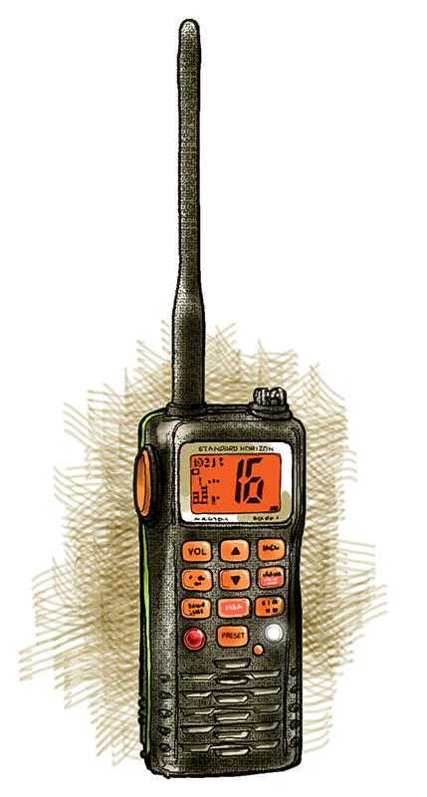
Marine VHF Setup and Components
A Marine VHF radio system consists of several essential components: 1. Transceiver Unit: The main device for transmitting and receiving messages May include built-in DSC and GPS modules 2. Microphone (Mic): Usually has a Push-to-Talk (PTT) button Some have keypads or channel selectors 3. Antenna: Crucial for signal strength and range Mounted as high as possible on the vessel Regular inspection for corrosion or loose connectors is necessary 4. Power Supply: Typically draws from the ship’s 12V or 24V battery system Handhelds use rechargeable batteries 5. Display Screen & Controls: Shows current channel, GPS position (if available), signal strength Buttons for changing channels, adjusting squelch, volume, DSC functions

Slide 8
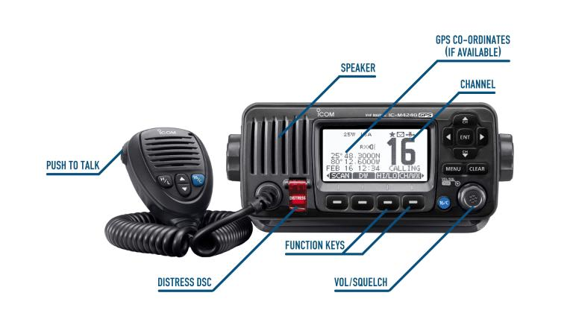
How to Operate a Marine VHF Radio
1. Turn on the radio and set to Channel 16 (always monitored by coast guards) 2. Adjust volume and squelch (reduces background noise) 3. Press the Push-to-Talk (PTT) button and speak clearly 4. Use standard communication phrases: “Over”: Finished speaking “Roger”: Message received “Say again”: Repeat your message “Out”: End of transmission 5. Always identify your vessel before beginning a call 6. Switch to a working channel after hailing on Ch. 16

Slide 9
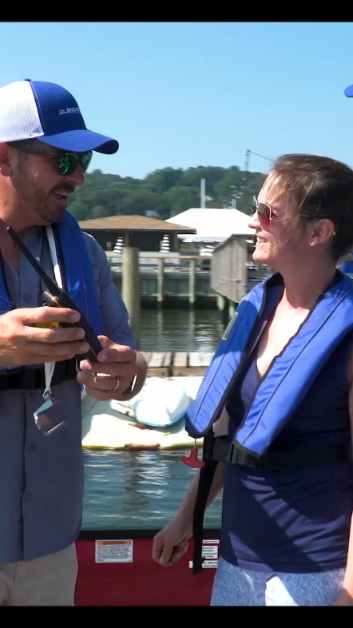
How to Operate a Marine VHF Radio
Lets watch a video

Slide 10
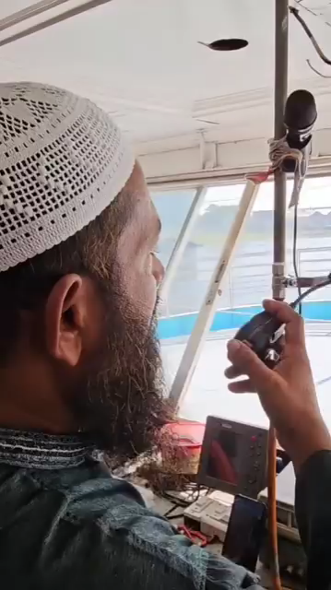
How to Operate a Marine VHF Radio
Let’s watch a another video

Slide 11
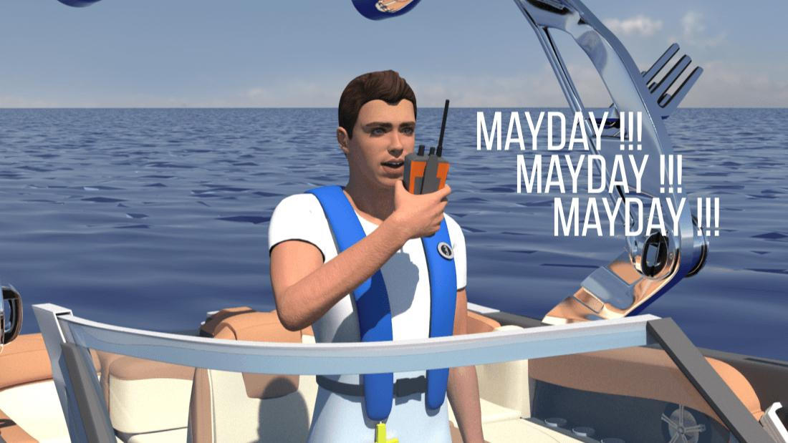
Emergency Communication Protocols
MAYDAY: Immediate life-threatening emergency (fire, sinking, man overboard) PAN-PAN: Urgency that is not life-threatening (engine failure, medical need) SÉCURITÉ: Navigational or meteorological warning (e.g. floating debris, storms) MAYDAY Example Format: “MAYDAY, MAYDAY, MAYDAY” “This is [Vessel Name], [Call Sign]” “Our position is [Latitude/Longitude]” “We are [description of emergency]” “We need immediate assistance”

Slide 12
VHF Radio Protocols and Etiquette
Always listen before transmitting Speak slowly and clearly Keep conversations short and professional Do not use VHF for casual chat Use Channel 16 for calling only, then move to a working channel In harbors or marinas, use low power mode to avoid interference Be polite, and avoid interrupting emergency or priority traffic Reminder: Improper use can lead to fines or imprisonment in some jurisdictions

Slide 13
Legal Obligations and Licensing
Many countries require a Ship Radio License issued by maritime authorities Operators (especially of fixed VHF radios with DSC) may require: ROC (Restricted Operator Certificate) or SRC (Short Range Certificate) You must register your VHF radio and get a MMSI to enable DSC functionality Failure to follow regulations may result in confiscation or fines

Slide 14
Maintenance and Troubleshooting
Perform pre-departure checks: power, antenna, signal strength, volume Clean connectors and terminals regularly Use marine-grade antennas, well-mounted for better range For handhelds: Fully charge before trips Keep dry and check waterproof seals Know how to test DSC signals if equipped Keep user manual onboard and learn emergency reset procedures

Slide 15
Final Thoughts / Conclusion
Marine VHF radios are not optional—they’re a lifesaving communication tool Proper use ensures safety, coordination, and legal compliance Know your channels, learn the language, and be prepared for emergencies Invest time in training—it can make the difference between life and death Closing Quote: “When at sea, your radio is your voice—make it count.”
Thank You for your Patients 😍

Slide 16

Question & Answer Session

